Slide 1

ECE 2700
Digital Circuits
Counters & Timers
Copyright © 2010 Frank Vahid
Instructors of courses requiring Vahid's Digital Design textbook (published by John Wiley and Sons) have permission to modify and use these slides for customary course-related activities, subject to keeping this copyright notice in place and unmodified. These slides may be posted as unanimated pdf versions on publicly-accessible course websites.. PowerPoint source (or pdf with animations) may not be posted to publicly-accessible websites, but may be posted for students on internal protected sites or distributed directly to students by other electronic means. Instructors may make printouts of the slides available to students for a reasonable photocopying charge, without incurring royalties. Any other use requires explicit permission. Instructors may obtain PowerPoint source or obtain special use permissions from Wiley – see http://www.ddvahid.com for information.

Slide 2
Today’s Objectives
To become familiar with the following datapath components
  Counters
  Timers
To understand how to use a timer to control an FSM

Slide 3
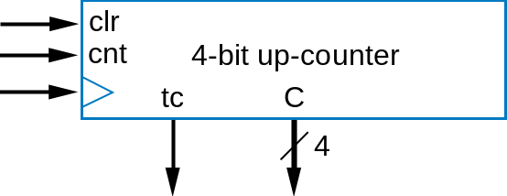
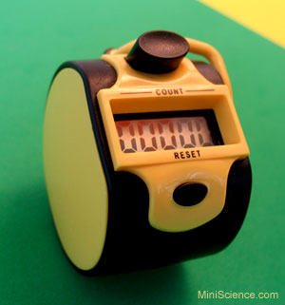
Counter
Sequential component
N-bit up-counter
  N-bit register that can increment (add 1) to its own value on each clock cycle
    0000, 0001, 0010, 0011, ...., 1110, 1111, 0000
  Count “rolls over” from 1111 to 0000
  Terminal (last) count, tc, equals1 during value just before rollover
    E.g., 1111 for a 4-bit counter
0
0
1
0
0011
0000
0001
0010
0100
0
0101
0000
0001
1110
1
...
1111

Slide 4
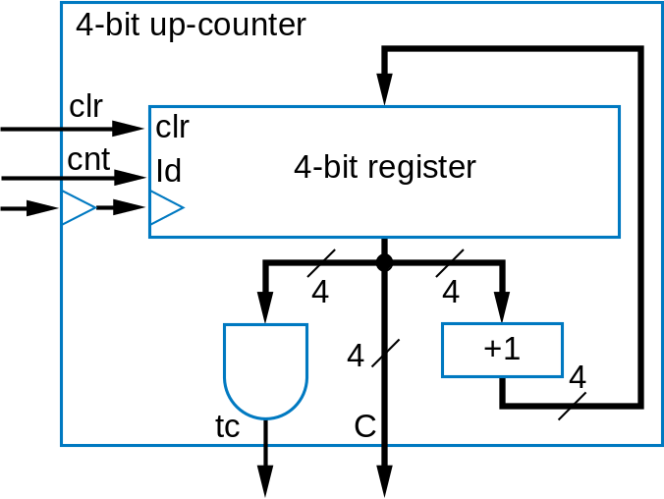
Up Counter Design
Register, incrementer, and
N-input AND gate to detect
terminal count
What is a design for a down counter like?

Slide 5
Up/Down Counter
Can count either
up or down
  Use dir input to
  select, via 2x1
  mux
    dir = 0 means up
  Likewise, dir selects
  appropriate
  terminal count value
  (all 1s or all 0s)
4-bit up/down counter
dir
1
4-bit 2
x
1
0
4
clr
clr
c
n
t
ld
4-bit register
4
4
4
4
4
–1
+1
4
4
1
2
x
1
0
t
c
C

Slide 6
Up Counter With Load
Up counter that can be loaded with external value
  Designed using 2x1 mux
  “load” input selects incremented value or
  external value
  Note that “load” has priority over “cnt”
L
4
load
1
4-bit 2x1
0
4
cnt
Id
clr
clr
4-bit register
4
4
4
+1
tc
C

Slide 7
Counter With Parallel Load
1000
Useful to create pulses at specific multiples of clock
  Example: Pulse every 9 clock cycles
  Use 4-bit down-counter with parallel load
  Set parallel load input to 8 (1000)
    Why load 8 and not 9? Because 0 is included in count sequence: 8, 7, 6, 5, 4, 3, 2, 1, 0 → 9 counts
  Use terminal count to reload
  When count reaches 0, next cycle loads 8
4
ld
L
1
4-bit down-counter
c
n
t
t
c
C
clk
4
slow signal

Slide 8
Common Counter Use: Clock Divider
Suppose we have a 512 MHz oscillator, but want 4 MHz pulse
  Divide fast clock by 128
    Use 7-bit up-counter
    Use tc output as pulse
    Counts from 0 to 127 (128 counts), so pulses tc every 128 cycles
1
cnt
7-bit up-counter
osc
tc
C
512 MHz
7
p
(unused)
4 MHz
What if we want to divide by a number that is not a power of 2?

Slide 9
Clock Divider
Example: 1 Hz pulse generator from 30 Hz clock
Divide clock by 30
  Use 5-bit up-counter
    We want to pulse every 30 cycles
    Detect 29
  Can also use down counter
    When count reaches 0, load 29
clr
1
cnt
5-bit up-counter
osc
tc
C
30 Hz
p
1
1
1
0
1
1 Hz
ld
1
cnt
5-bit down-counter
osc
tc
C
30 Hz
p
unused
1 Hz

Slide 10
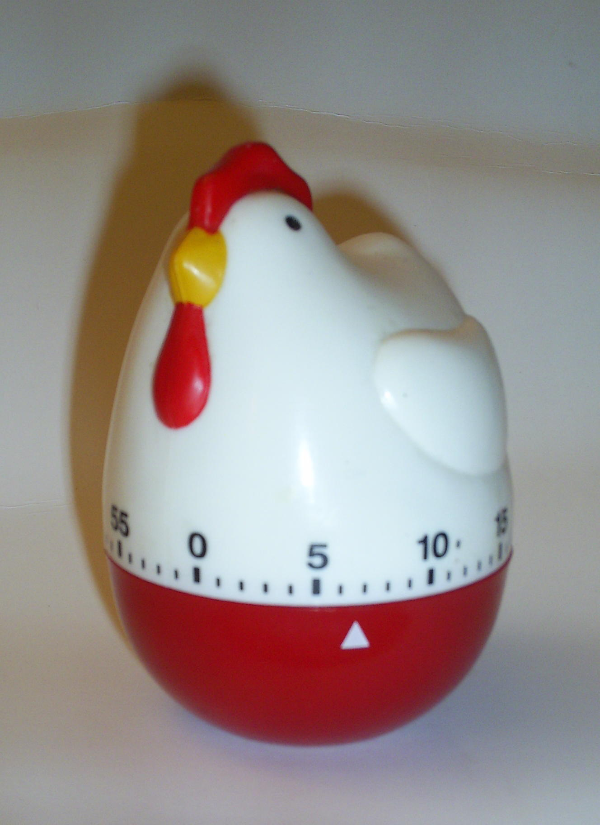
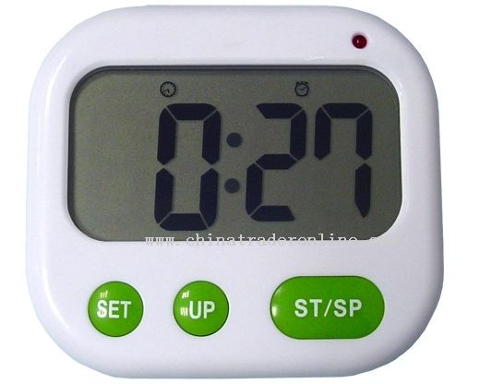
Timer
Pulses output at user-specified timer interval when enabled
  “Ticks” like a clock
  Interval specified as multiple of base time unit
    If base is 1 microsec and user wants pulse every 300 ms, loads 300,000 into timer

Slide 11
Timer Design
Can design using oscillator, register, and down-counter
M
-1
Q
32
load
ld
32-bit register
32
1
32-bit 2x1
0
load
M
ld
enable
32-bit
enable
32-bit
1-microsec
cnt
down-counter
Q
timer
1 microsec
tc
C
oscillator
Q
unused

Slide 12
Example
Washing machine FSM
  Starts when a coin is deposited
  Cycles through
    Soak
    Wash
    Rinse
    Spin
  Each cycle takes 30 minutes
  An LED light turns on when all the cycles have completed

Slide 13
Traffic Light Control
Inputs
  2 sensors (inductives loop of wire placed under pavement) to detect if a car is waiting
    One for the north-south direction (senNS)
    One for the east-west direction (senEW)
Outputs
  2 lights—red (0) or green (1)
    One for the north-south direction (lightNS)
    One for the east-west direction (lightEW)
Desired behaviors
  Initial state: green light for north-south direction
  Light stays green for 30 seconds, then change to red if a car is waiting in the other direction. Otherwise, light stays green for another 30 seconds
  If there are cars waiting in both directions, switch to the other direction
N

Slide 14
Today’s Objectives
To become familiar with the following datapath components
  Counters
  Timers
To understand how to use a timer to control an FSM

